Slide 1
II-B.TECH. III-SEMESTER
Data Structure (DS)
Presented By
Dr. D. BASWARAJ
Professor, CSE DEPT.
VCE, HYDERABAD

Slide 2
COURSE OBJECTIVES
Identify and use appropriate data structure for a given problem with effective utilization of space and time.
Describe the linear and nonlinear data structures
Analyze the complexities of different sorting techniques

Slide 3
COURSE OUTCOMES
Compute time and space complexities of Algorithms. Design a solution to a given problem using arrays.
Develop applications using stacks, queues and linked lists.
Choose the appropriate nonlinear data structure and perform operations on them.
Choose suitable sorting technique to maximize the performance of the solution. Select the hashing technique to perform dictionary operations.
5. Explain operations on Efficient Binary Search Trees and Multiway Search Trees.

Slide 4
SYLLABUS
UNIT – I:
Basic concepts: Algorithm Specification - Introduction, Recursive algorithms, Data Abstraction, Performance analysis- time complexity and space complexity, Asymptotic Notation-Big O, Omega and Theta notations. Arrays: Arrays - ADT, Polynomials, Sparse matrices, Strings-ADT, Pattern Matching
UNIT – II:
Stacks and Queues: Stacks, Stacks using dynamic arrays, Queues, Circular Queues using dynamic arrays, A Mazing Problem, Evaluation of Expressions - Evaluating Postfix Expression, Infix to Postfix.
Linked Lists: Singly Linked Lists and Chains, Linked Stacks and Queues, Polynomials, Operations for Circularly linked lists, Equivalence Classes, Sparse matrices, Doubly Linked Lists

Slide 5
SYLLABUS …
UNIT – III:
Trees: Introduction, Binary Trees, Binary Tree Traversals, Heaps, Binary Search trees (BST): Definition, Searching a BST, Insertion into a BST, Deletion from a BST.
Graphs: The Graph ADT, Elementary graph operations, Minimum Cost Spanning Trees- Kruskal's Algorithm, Prim's Algorithm.
UNIT – IV:
Sorting: Insertion Sort, Quick sort, Merge sort, Heap sort, Sorting on Several Keys, List and Table Sorts.
Hashing :Introduction, Static Hashing: Hash tables, Hash functions, Overflow handlings.
UNIT – V:
Efficient Binary Search Trees: AVL Trees, Red-Black Trees, Splay Trees. Multiway Search Trees: m-way search trees-Definition and properties, Searching an m-way search tree, B-Trees-Definition and properties, Number of Elements in a B-Tree, Insertion into a B-Tree and Deletion from a B-Tree.

Slide 6
SYLLABUS …
Learning Resources:
Horowitz E, Sahni S and Susan Anderson-Freed, Fundamentals of Data structures in C, 2nd Edition(2008), Universities Press.
Mark A Weiss, Data Structures and Algorithm Analysis In C, 2nd Edition (2002), Pearson.
Kushwaha D. S and Misra A.K, Data Structures A Programming Approach with C, Second Edition(2014), PHl.
Gilberg R. F and Forouzan B. A, Data Structures: A Pseudocode Approach with C, Second Edition(2007), Cengage Leaming
https://ocw.mit.edu/courses/electrical-engineering-and-computer-science/6-006- introduction-to-algorithms-fall-2011/lecture-videos
http://nptel.ac.in/courses/106106127/
http://www.nptel.ac.in/courses/106102064

Slide 7
UNIT-I
PART-1: Basic Concepts
  Algorithm Specification - Introduction
  Recursive algorithms
  Data Abstraction
  Performance analysis- time complexity and space complexity
  Asymptotic Notation-Big O, Omega and Theta notations
PART-2: Arrays and Strings
  Arrays – ADT
  Polynomials
  Sparse matrices
  Strings-ADT
  Pattern Matching

Slide 8
Part-1: Basic Concepts
Data Structure Definition:
A data structure is a particular way of organizing data in a computer (memory) so that it can be used effectively.
In other words, a data structure is a data organization, management, and storage format that enables efficient access and modification.
More precisely, a data structure is a collection of data values, the relationships among them, and the functions or operations that can be applied to the data.
Data Structures classified in to two categories: Primitive and Non-Primitive.

Slide 9
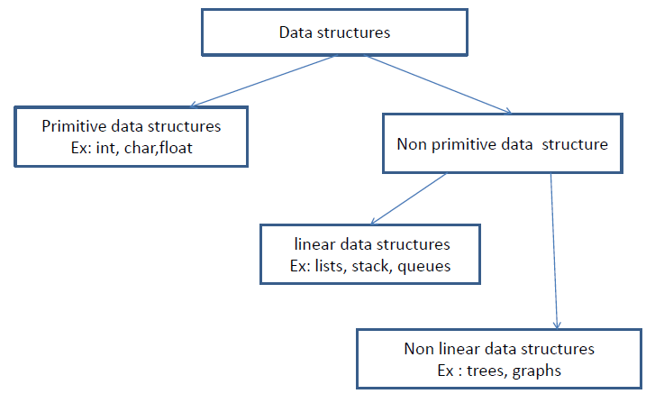
Types of Data Structures

Slide 10
Types of Data Structures
Primitive Data Structures are the basic data structures that directly operate upon the machine instructions.
Example: Integer, Float, Char, Double and Pointer
Non-primitive data structures are more complicated data structures and are derived from primitive data structures.
They emphasize on grouping same or different data items with relationship between each data item.
Non-Primitive DS further divided in to two type:
Linear (Sequential): Arrays, Linked Lists, Stacks, Queues
Non-Linear (Random): Trees, Graphs

Slide 11
Common Operations on Data Structures
Read / View
Write / Store
Searching
Sorting – Ascending / Descending
Insertion
Deletion
Updation
(Youtube Video Link: https://youtu.be/DFpWCl_49i0)

Slide 12
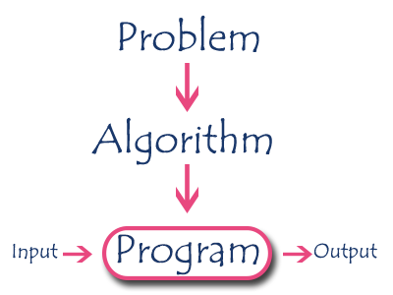
1. Introduction to Algorithm
An algorithm is a step by step procedure to solve a problem.
In normal language, algorithm is defined as a sequence of statements which are used to perform a task.
In computer science, an algorithm can be defined as, sequence of unambiguous instructions used for solving a problem, which can be implemented (as a program) on a computer.

Slide 13
Algorithm Specifications / Properties
Every algorithm must satisfy the following specifications:
  Input - Every algorithm must take zero or more number of input values from external.
  Output - Every algorithm must produce an output as result.
  Definiteness - Every statement/instruction in an algorithm must be clear and unambiguous (only one interpretation)
  Finiteness - For all different cases, the algorithm must produce result within a finite number of steps.
  Effectiveness - Every instruction must be basic enough to be carried out and it also must be feasible.
  (YouTube Video URL: https://www.youtube.com/watch?v=FbYzBWdhMb0)

Slide 14
Algorithm Example
Problem Statement: Find the largest number in the given list of numbers?
Input: A list L of positive integer numbers. (List must contain at least one number).
Output: The largest number max in the given list of positive integer numbers.
Algorithm:
Step 1: Define a variable 'max' and initialize with '0'.
Step 2: Compare first number (say 'x') in the list 'L' with 'max', if 'x' is larger than 'max', set 'max' to 'x'.
Step 3: Repeat step 2 for all numbers in the list 'L'.
Step 4: Display the value of 'max' as a result.

Slide 15
PSEUDO CODE
It is a representation of algorithm in which instruction sequence can be given with the help of programming constructs. or
Pseudo code, on the other hand, is not a programming language, but simply an informal way of describing a program.
Example: write an algorithm to find sum of 1 to n numbers
Algorithm sum(1,n)
{
Result:=0;
for i :=1 to n do Result := Result + i;
Write Result
}

Slide 16
2. Recursive algorithms
In computer science, most of the algorithms are implemented by using functions (which are part of program and invoked whenever required).
We can view a function as something that is invoked (called) by another function. It executes its code and then returns control to the calling function.
Here, a function can call themselves (by itself) or it may call another function. The function which calls by itself is called as Direct Recursive function or Recursive function.
The algorithms which uses recursive functions to solve the problems are called Recursive Algorithms.
These recursive algorithms are easier to understand when compared to its iterative counterpart.

Slide 17

Example
Write an recursive algorithm to find factorial of given number.
Algorithm factorial(n)
{
fact=1
if (n > 1) fact = n* factorial(n-1);
Return (fact);
}
In the above pseudo code, the algorithm factorial called itself until the given number is greater than one.

Slide 18
3. Data Abstraction
Data Abstraction is a process of providing only the essential details to the outside world and hiding the internal details, i.e., representing only the essential details in the program.
Data Abstraction is a programming technique that depends on the separation of the interface and implementation details of the program.
C provides a great level of abstraction. For example, printf() function is used to display message along with result without knowing the algorithm of the function printf().
Data Abstraction avoids the code duplication, i.e., programmer does not have to undergo the same tasks every time to perform the similar operation.
Internal implementation can be changed without affecting the user level code.

Slide 19
Abstract Data Type (ADT)…
Abstract Data type (ADT) is a type (or class) for objects whose behavior is defined by a set of value and a set of operations.
The definition of ADT only mentions what operations are to be performed but not how these operations will be implemented.
It does not specify how data will be organized in memory and what algorithms will be used for implementing the operations.
It is called “abstract” because it gives an implementation-independent view.
The process of providing only the essentials and hiding the details is known as abstraction.
For example, Primitive values like int, float, char data types only with the knowledge that these data type can operate and be performed on without any idea of how they are implemented.

Slide 20
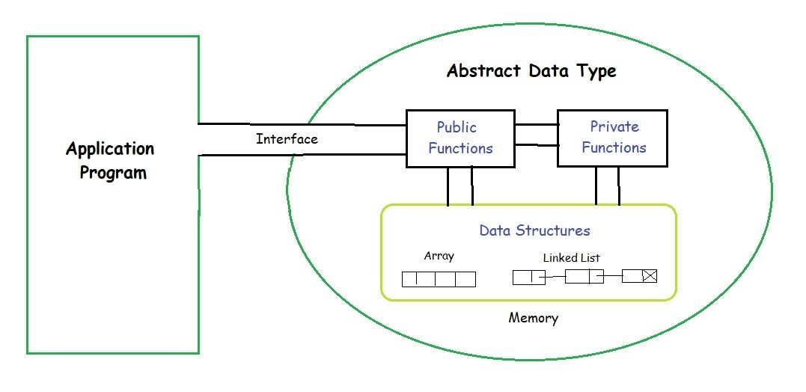
Abstract Data Type (ADT)…
So a user only needs to know what a data type can do, but not how it will be implemented.
Think of ADT as a black box which hides the inner structure and design of the data type. Now we’ll define three ADTs namely List ADT, Stack ADT, Queue ADT.

Slide 21
Abstract Data Type (ADT)…
Example: List ADT
A list contains elements of the same type arranged in sequential order and following operations can be performed on the list.
get() – Return an element from the list at any given position.
insert() – Insert an element at any position of the list.
remove() – Remove the first occurrence of any element from a non-empty list.
removeAt() – Remove the element at a specified location from a non-empty list.
replace() – Replace an element at any position by another element.
size() – Return the number of elements in the list.
isEmpty() – Return true if the list is empty, otherwise return false.
isFull() – Return true if the list is full, otherwise return false.

Slide 22
4. Performance analysis- time complexity and space complexity
The efficiency of an algorithm can be decided by measuring the performance of an algorithm
Performance analysis helps us to select the best algorithm from multiple algorithms to solve a given problem.
Generally, the performance of an algorithm depends on the following elements:
  Whether that algorithm is providing the exact solution for the problem?
  Whether it is easy to understand?
  Whether it is easy to implement?
  How much space (memory) it requires to solve the problem?
  How much time it takes to solve the problem?

Slide 23
Space Complexity
The performance of an algorithm measured mainly by computing amount of time (time complexity ) and storage requirement (space complexity).
Space Complexity is the amount of main memory space required to store and execute the program implemented on given algorithm.
Generally, when a program is under execution it uses the computer memory for 3 reasons. They are as follows...
Instruction Space: It is the amount of memory used to store compiled version of instructions.
Environmental Stack: It is the amount of memory used to store information of partially executed functions at the time of function call.
Data Space: It is the amount of memory used to store all the variables and constants.

Slide 24
Space Complexity…
When we want to perform analysis of an algorithm based on its Space complexity, we consider only Data Space and ignore Instruction Space as well as Environmental Stack since it tale less space as compared to data space.
To calculate the space complexity, we must know the memory required to store different data type values, for example, in C the space required as:
  2 bytes to store integer value,
  4 bytes to store floating Point value,
  1 byte to store character value,
  8 bytes to store double value
If any algorithm requires a fixed amount of space for all input values then that space complexity is said to be Constant Space Complexity.

Slide 25
Space Complexity Examples
Consider the following piece of code...
int square(int a)
return a*a;
In above piece of code, the space complexity is constant and its value is 2 +2 = 4.
Consider the following piece of code...
int sum (int A[], int n) { // 2n, 2
int i, s = 0; // 2, 2
for(i = 0; i < n; i++)
s = s + A[i];
return s; } //2
In above piece of code, the space complexity is Linear and its value is (2n+8).

Slide 26
Time Complexity
The time complexity of an algorithm is the total amount of time required by an algorithm to complete its execution.
When we calculate time complexity of an algorithm, we consider only input data and ignore the remaining things, as they are machine dependent.
We check only, how our program is behaving for the different input values to perform all the operations like Arithmetic, Logical, Return value and Assignment etc.,.
Calculating Time Complexity of an algorithm based on the system configuration is a very difficult task because, the configuration changes from one system to another system.
The time complexity is given in terms of frequency count denoting number of times the statement executed.

Slide 27
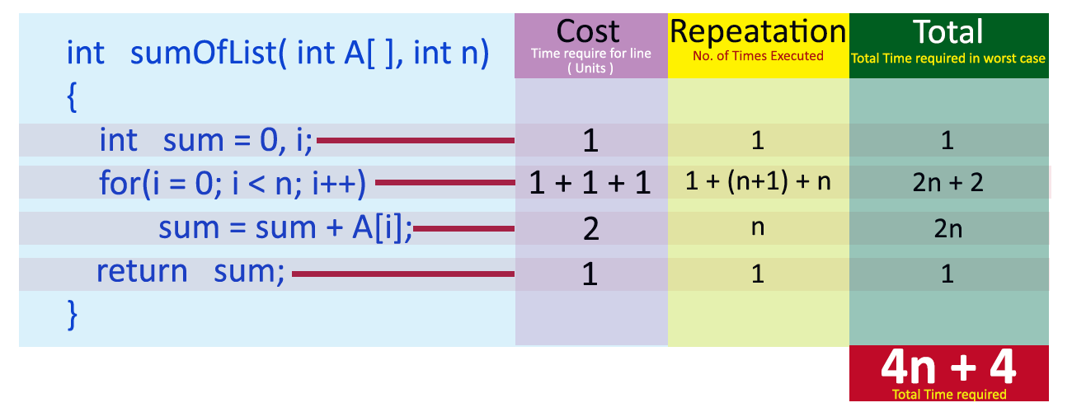
Time Complexity Examples
Consider the following piece of code...
int square(int a) return a*a;
In above piece of code, the time complexity is constant and its value is 2 units of time. Consider the following piece of code...
In above piece of code, the time complexity is Linear and its value is (4n+4) units of time.

Slide 28
5. Asymptotic Notation-Big O, Omega and Theta notations
The time complexity is computed using run time is calculated by input size and asymptotic notations .
Input size: the input size of any instance of a problem is defined as the number of words required to describe that instance of problem.
Asymptotic notations: This is the shorthand way to represent the time complexity.
Time complexity is given as fastest possible, slowest possible or average time.
Notations such as Ω, θ, Ο are the asymptotic notations.

Slide 29
Big Oh Notation
It represents the upper bound of algorithms running time.
The longest amount of time taken by the algorithm to complete is calculated by big oh (Ο).
Def: let f(n) and g(n) are two non-negative functions. And is there exists an integer no and constant C such that C>0 and for all integers n>n₀ ,f(n) <= c*g(n), then f(n) is big oh of g(n). It is also denoted as “ f(n) = Ο (g(n))”.
Various meanings associated with big-oh are
  O(1)- constant computing time
  O(n)- linear
  O(n²)-quadratic
  O(n³)-cubic
  O(2^{n})-exponential
  O(log n)-logarithmic

Slide 30
6. Arrays – ADT
Whenever we want to work with large number of data values, we need corresponding different variables.
As the number of variables are increasing, complexity of the program increases and also there may be situations in which we need to work with large number of similar data values.
To make this work more easy, C programming language provides a concept called "Array".
An array is a variable which can store multiple values of same data type at a time i.e. "Collection of similar data items stored in continuous / contiguous memory locations with single name”.

Slide 31
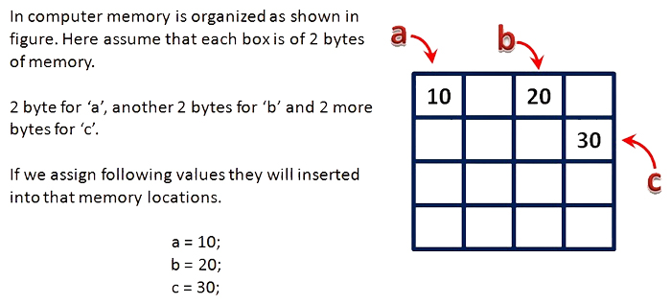
Arrays…
To understand the concept of arrays, consider the following example declaration.
int a, b, c;
Here, the compiler allocates 2 bytes of memory with name 'a', another 2 bytes of memory with name 'b' and more 2 bytes with name 'c'.
These three memory locations are may be in sequence or may not be in sequence. Here these individual variables can store only one value at a time.

Slide 32
Abstract Data Type (ADT)…
Abstract Data type (ADT) is a type (or class) for objects whose behavior is defined by a set of value and a set of operations.
Array / List ADT: A list contains elements of the same type arranged in sequential order and following operations can be performed on the list.
  get() – Return an element from the list at any given position.
  insert() – Insert an element at any position of the list.
  remove() – Remove the first occurrence of any element from a non-empty list.
  removeAt() – Remove the element at a specified location from a non-empty list.
  replace() – Replace an element at any position by another element.
  size() – Return the number of elements in the list.
  isEmpty() – Return true if the list is empty, otherwise return false.
  isFull() – Return true if the list is full, otherwise return false.

Slide 33
7. Polynomials
A polynomial is composed of different terms where each of them holds a coefficient and an exponent.
A polynomial p(x) is the expression in variable x which is in the form (ax^{n} + bx^{n-1} + …. + jx+ k), where a, b, c …., k fall in the category of real numbers and 'n' is non negative integer, which is called the degree of polynomial.
An essential characteristic of the polynomial is that each term in the polynomial expression consists of two parts:
one is the coefficient
other is the exponent
Example:
10x² + 26x, here 10 and 26 are coefficients and 2, 1 is its exponential value.

Slide 34
Polynomials
Points to keep in Mind while working with Polynomials:
The sign of each coefficient and exponent is stored within the coefficient and the exponent itself.
Additional terms having equal exponent is possible one.
The storage allocation for each term in the polynomial must be done in ascending and descending order of their exponent.
Polynomial can be represented in the various ways. These are:
By the use of arrays
By the use of Linked List
In array, the simple way is to represent a polynomial with degree 'n' and store the coefficient of n+1 terms of the polynomial in the array. So every array element will consist of two values: Coefficient and Exponent.

Slide 35
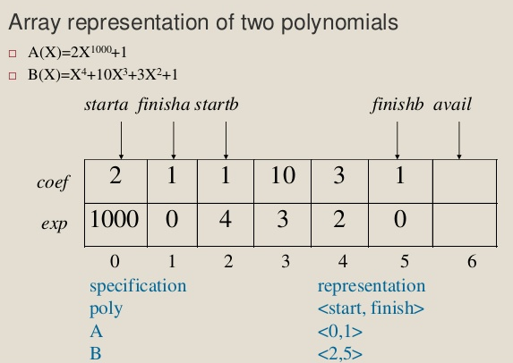
Polynomials Representation Example…

Slide 36
8. Sparse matrices
In computer programming, a matrix can be defined with a 2-dimensional array (m x n).
There may be a situation in which a matrix contains more number of ZERO values than NON-ZERO values. Such matrix is known as sparse matrix i.e. which contains very few non-zero elements.
When a sparse matrix is represented with 2-dimensional array, we waste lot of space to represent that matrix.
For example, consider a matrix of size 100 x 100 containing only 10 non-zero elements. That means, totally we allocate 100 x 100 x 2 = 20000 bytes of space to store this integer matrix.
And to access these 10 non-zero elements we have to make scanning for 10000 times.
Sparse Matrix Representations: Triplet Representation and Linked Representation.

Slide 37
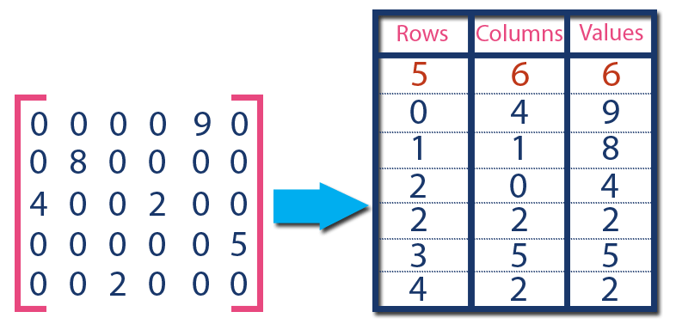
Triplet Representation
In this representation, we consider only non-zero values along with their row and column index values.
In this representation, the 0th row stores total rows, total columns and total non-zero values in the matrix.
For example, consider a matrix of size 5 x 6 containing 6 number of non-zero values and can be represented as shown below…

Slide 38
9. Abstract String / String ADT
The Abstract String is a programmer-defined linear ordering of objects from a finite set of objects termed an alphabet.
The alphabet may be restricted to alphanumeric and punctuation characters but may also include additional mark-up information such as a new line character.
Strings, unlike a more general list, are generally assumed to have information coded not only in the individual characters but also in the ordering of the characters.
Properties:
  The component characters are from the ASCII character set
  They are comparable in lexicographic order
  They have a length, from 0 to the specified length

Slide 39
String ADT…
If characters can be inserted, modified, or removed from a string, the string is said to be mutable. Otherwise, the string is immutable.
Strings, for example. We spent a long time looking at strings, and we know that a string is just a piece of data with a well-defined type that has well-defined characteristics (it’s a char *, with a '\0' at the end) and that there are some fairly common operations on Strings.
Example: char *s1=“abcde”
Critical Operations for Abstract Strings
  The concatenation of two strings,
  The extraction of substrings,
  Searching a string for a matching substring,
  Matching regular expressions,
  Parsing and others...

Slide 40
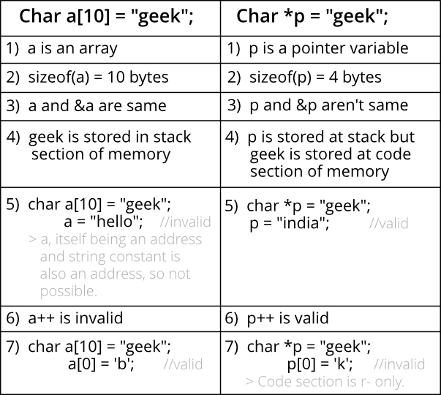
Differences between string and character Array…

Slide 41
String Implementations…
Example: Read & write Strings in C using Printf() and Scanf() functions
#include <stdio.h>
#include <string.h>
int main() {
char nickname[20]; /* String Declaration*/
printf("Enter your Nick name:");
/* I am reading the input string and storing it in nickname * Array
name alone works as a base address of array so * we can use
nickname instead of &nickname here */
scanf("%s", nickname);
printf("%s",nickname); /*Displaying String*/
return 0;
}

Slide 42
String Implementations…
  Example: Read & Write Strings in C using gets() and puts() functions
#include <stdio.h>
#include <string.h>
int main()
{
char nickname[20]; /* String Declaration*/
puts("Enter your Nick name:");
gets(nickname); /*Input using gets*/
puts(nickname); /* Console display using puts */
return 0;
}

Slide 43
String Implementations…
Example: To count upper case, lower case and special characters in a string
#include<stdio.h>
void main() {
char text[100]; int i, countL, countU,countS;
printf("Enter any string: "); gets(text);
printf("Entered string is: %s\n",text);
countL=countU=countS=0;
for(i=0;text[i]!='\0';i++) {
if (text[i]>='A' && text[i]<='Z')
countU++;
else if (text[i]>='a' && text[i]<='z')
countL++;
else countS++; }
printf("Upper case characters: %d\n",countU);
printf("Lower case characters: %d\n",countL);
printf("Special characters: %d\n",countS); }

Slide 44
10. Pattern Matching
Naive algorithm for Pattern Searching:
Given a text txt[0..n-1] and a pattern pat[0..m-1], write a function search(char pat[], char txt[]) that prints all occurrences of pat[] in txt[]. You may assume that n > m.
Example-1:
  Input: txt[] = "THIS IS A TEST TEXT"
  pat[] = "TEST"
  Output: Pattern found at index 10
Example-2:
  Input: txt[] = "AABAACAADAABAABA"
  pat[] = "AABA"
  Output: Pattern found at index 0
  Pattern found at index 9
  Pattern found at index 12.

Slide 45
Pattern Matching…
In this case, slide the pattern over text one by one and check for a match. If a match is found, then slides by 1 again to check for subsequent matches..
The complexity of this function is O(N.M).
  void search(char* pat, char* txt) {
  int M = strlen(pat), N = strlen(txt);
  for (int i = 0; i <= N - M; i++) { /* A loop to slide pat[] one by one */
  int j;
  for (j = 0; j < M; j++) /* For current index i, check for pattern match */
  if (txt[i + j] != pat[j]) break;
  if (j == M) // if pat[0...M-1] = txt[i, i+1, ...i+M-1]
  printf("Pattern found at index %d \n", i);
  }
  }

Slide 46
Pattern Matching…
KMP (Knuth Morris Pratt) algorithm for Pattern Searching:
The Naive pattern searching algorithm doesn’t work well in cases where we see many matching characters followed by a mismatching character.
Following are some examples.
  txt[] = "AAAAAAAAAAAAAAAAAB"
  pat[] = "AAAAB"
  txt[] = "ABABABCABABABCABABABC"
  pat[] = "ABABAC" (not a worst case, but a bad case for Naive)
The KMP matching algorithm uses degenerating property (pattern having same sub-patterns appearing more than once in the pattern) of the pattern and improves the worst case complexity to O(N).
In this, whenever we detect a mismatch (after some matches), we already know some of the characters in the text of the next window.

Slide 47
Pattern Matching…
We take advantage of this information to avoid matching the characters that we know will anyway match.
void KMPSearch(char* pat, char* txt) {
int M = strlen(pat), int N = strlen(txt);
int lps[M]; // lps will hold the longest prefix suffix values for pattern
computeLPSArray(pat, M, lps); // Preprocess the pattern (calculate lps)
int i = 0, j = 0; // index for txt[] and pat[]
while (i < N) {
if (pat[j] == txt[i]) { j++; i++; }
if (j == M) { printf("Found pattern at index %d ", i - j);
j = lps[j - 1]; }
else if (i < N && pat[j] != txt[i]) { // mismatch after j matches
if (j != 0) j = lps[j - 1]; else i = i + 1;
}
}
}

Slide 48
Pattern Matching…
// Fills lps[] for given patttern pat[0..M-1]
void computeLPSArray(char* pat, int M, int* lps) {
int len = 0; // length of the previous longest prefix suffix
lps[0] = 0; // lps[0] is always 0
int i = 1; // the loop calculates lps[i] for i = 1 to M-1
while (i < M) {
if (pat[i] == pat[len]) {
len++; lps[i] = len; i++; }
else // (pat[i] != pat[len])
{ // This is tricky
if (len != 0) len = lps[len - 1];
else { lps[i] = 0; i++; }
}
}

Slide 49
END OF
UNIT-1

